Slide 1
The Vision
Full Gospel Business Men's Fellowship International
fgbmfiVOICE.com

Slide 2
The Full Gospel Business Men's Fellowship International was started in 1951 by our founder Demos Shakarian
After a first year of struggle Demos was about to give up, so he went to God in prayer on December 26, 1952
He was shown a Vision of lifeless, miserable people turned to joyfull, loving, God worshipping people.
After this divine confirmation the Fellowship has spread first throughout the US, then to the whole world, reaching out and changing people’s lives everywhere!

Slide 3
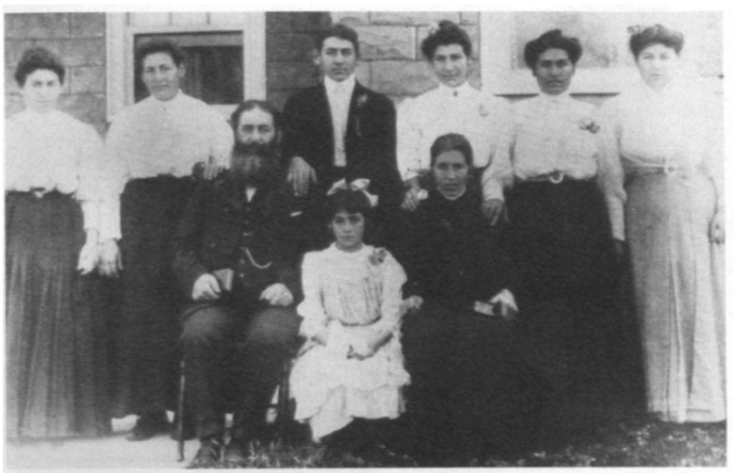
Origins
The Shakarian family lived in Armenia
The child prophet Efim of the village had announced a persecution of Christians
They had to flee across the seas, to the United States of America, to the west coast
In 1905 Demos Shakarian with his wife, six daughters, and son Isaac, aged thirteen, left for America.

Slide 4
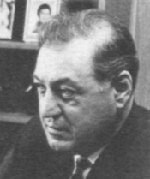
Our founder Demos
On July 21, 1913 Isaac had his first child, a boy.
They give him the same name as his grandfather : Demos.
It is this Demos, the one born in America, who is our founder, not the grandfather!
Demos realizes that the men he worked with every day never talked about God, although there were plenty of churches in Los Angeles.
For several years he organized meetings with invited evangelists

Slide 5
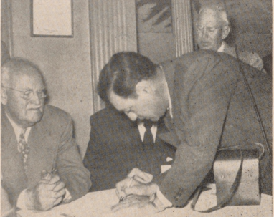
START IN 1951
In 1951 Demos began the Full Gospel Business Men's Fellowship International.
Full Gospel. No taboo subjects at meetings. Healing. LANGUAGES. Deliverance. Men would talk about their experiences with God as they happened, not theories.
Business Men. Lay people. Common men.
Fellowship. A group of people who will be happy to meet again. Nothing about committees, agendas and regulations.
International. The whole world. All flesh.

Slide 6
FAILURE
Only 21 people came to the first meeting in CAFETERIA CLIFTON LOS ANGELES
A whole year Demos tries to grow the community
He does everything and travels everywhere
On December 26, 1952 he was about to give up and went to prayer
Then God showed him a vision in 2 parts

Slide 7
Vision of lost people
Demos felt like he was leaving his body. He went up until he could see the whole country from coast to coast.
But he could also see the millions of inhabitants. And then he could make out the details of their faces.
And Demos was terrified. The faces were frozen, lifeless, miserable. Physically they were very close to each other. But there was no real contact between them. They were dead...
Then Demos saw South America, the African continent, Europe, Asia.
More frozen, pitiful faces, each of them imprisoned in their own death.
In his vision Demos cried out “Lord, help them!”. And he felt like he was interceding out loud while crying.

Slide 8
Vision of saved people
Then he heard: “My son, what you are going to see now will not take long to happen.”
For the second time the earth rotated below Demos. Again he saw millions and millions of men.
But now everyone raised their heads, their eyes shone with joy, their hands stretched towards the sky.
They were bound together in a community of love and worship. Everywhere death was changed into life.
The vision was over. It was half past three in the morning.

Slide 9
Current state of affairs
Now the Fellowship is present in many countries
We are not a church – but we are lay people – no stained glass church windows
We meet in neutral places, such as hotels, restaurants and cafes
And in these modern times also online like in zoom meetings
We organize ourselves into chapters, which are groups of men, women or mixed people, or young people.
fgbmfiVOICE.com

